Slide 1

Resume Classification
Team Members(Group 4)
Ms. Prajkta Mrugendra Sodde
Mr. Shiva Kumar Ande
Mr. Khadye Akshay Krishnakant
Ms. Athira P R
Ms. Dipali Suresh Pimpalkar
Mr. Sattenapalli Murari
Mr. Praphullkumar Bapu Dhumal
Mentor : Mr. Advaith

Slide 2
Business objective
The resume classification solution should significantly reduce the manual human effort in the HRM. It should achieve a higher level of an accuracy and automation with minimal human intervention.

Slide 3

Problem
Notes:
To classify the resumes revceived from candidates to correct category

Slide 4
Problem
A
B
C
D

Slide 5
Project Flow
Data Collection
EDA
Data cleaning
Model Building
Classification Model
Textract
Deployment
RShiny or Flask or stream lit

Slide 6
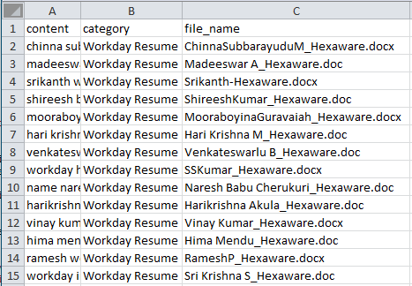
Data Collection
Textract

Slide 7
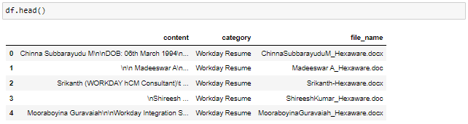
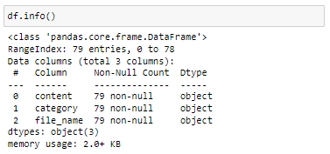
Exploratory Data Analysis

Slide 8
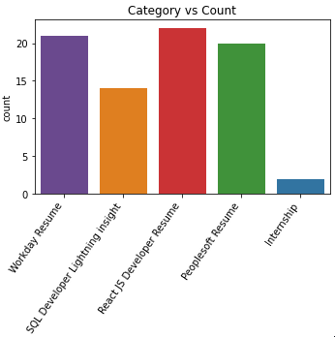
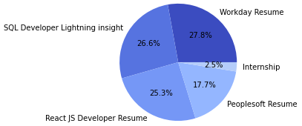
Exploratory Data Analysis
Category Distribution/count

Slide 9

Exploratory Data Analysis
Data Cleaning
lower the text
Remove all the unwanted characters

Slide 10
Exploratory Data Analysis
Data Cleaning
Word Tokenization
Remove stop words

Slide 11


Exploratory Data Analysis
Data Cleaning
Stemming
Lemmatization

Slide 12
Exploratory Data Analysis
A
Wordcloud
B
C
A : Peoplesoft Resume
B : React JS Developer
C : SQL Developer
D : Workday Resumes
D

Slide 13
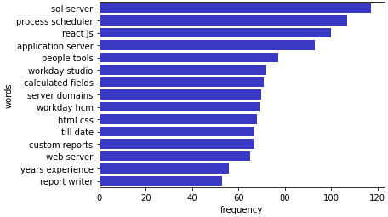
Exploratory Data Analysis
Mostly repeated bigrams

Slide 14
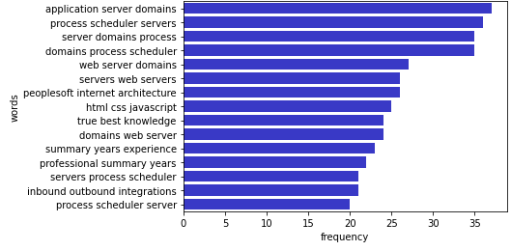
Exploratory Data Analysis
Mostly repeated trigrams

Slide 15
Model Building.....
Split Data
Using Tfidf Vectoriser convert collection or row data into metrics forms.
Split the into training and testing datasets.

Slide 16
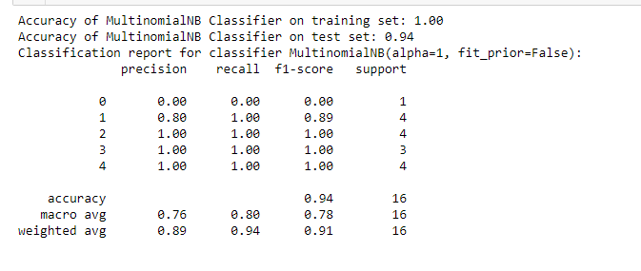
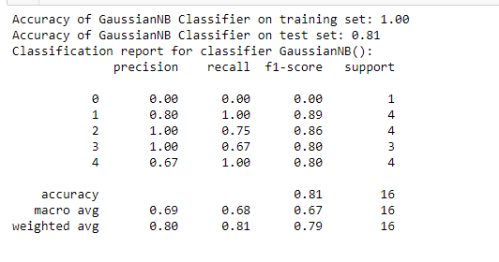
1. Naive Bayes
A) Multinomial NB
B) Gaussian NB

Slide 17
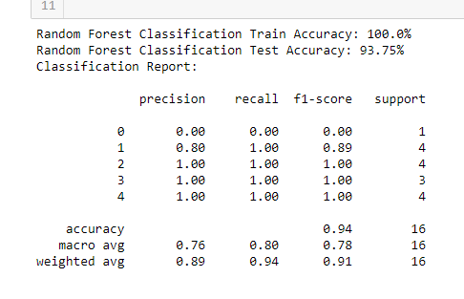
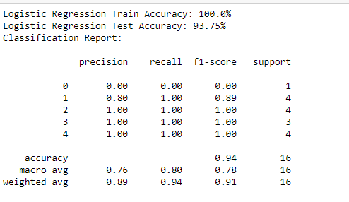
2. Random Forest Classifier.
3. Logistic Classifier.

Slide 18
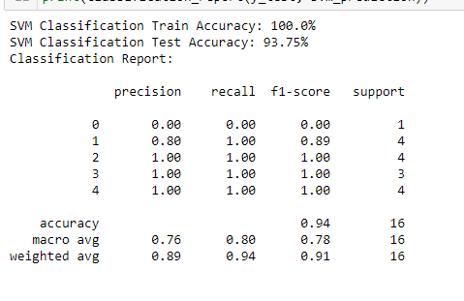
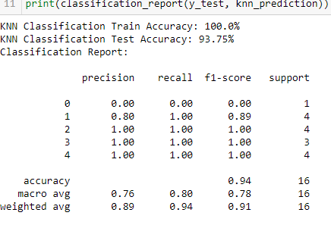
4.SVM
5. KNN

Slide 19
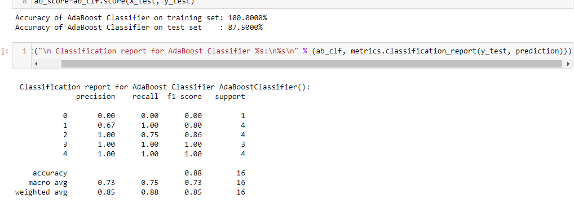
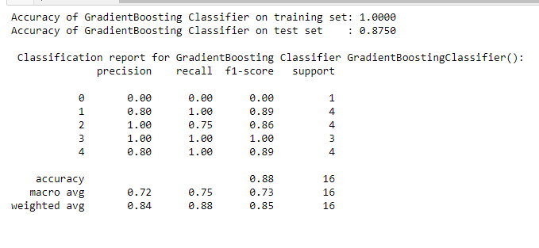
6. AdaBoost classifier.
7.GradiantBoost Classifier

Slide 20
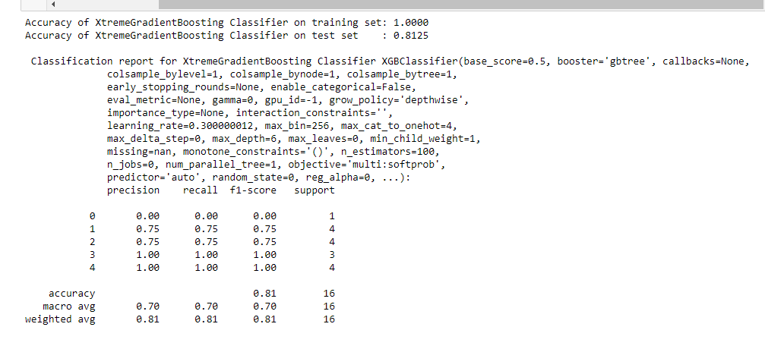
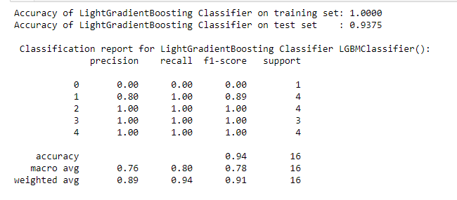
8. XGB Classifier.
9.LGBM Classifier

Slide 21
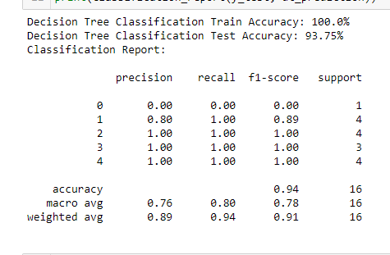
10. Decision Tree Classification.

Slide 22
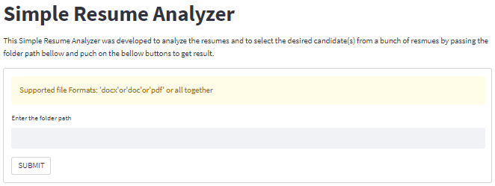
Deplyment
Web Interface of streamlit Deployment

Slide 23
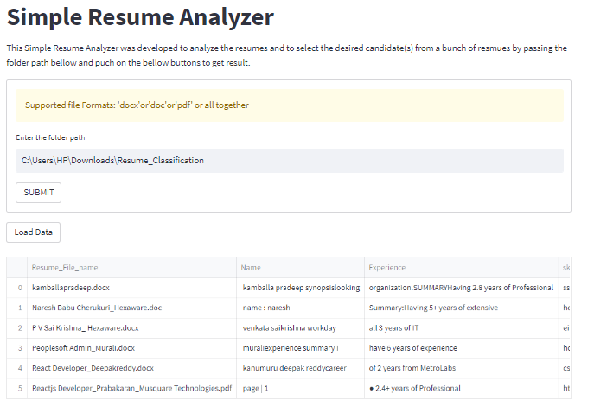
Deplyment
Result

Slide 24
Thank You

